Slide 1

Vel Tech Rangarajan Dr. Sagunthala R&D Institute of Science and Technology
School of Computing
Department of Computer Science and Engineering
10211CS224 / FULL STACK APPLICATION DEVELOPMENT (JAVA)
PROJECT REVIEW : MILESTONE PROJECT – 1
Date: 24-03-2026
Responsive E-Commerce Interface with State-Persistent Cart
SDG: SDG 8 – Decent Work and Economic Growth
Presented By:
P.Nivethitha – VTU24312 – Reg.No:23UECS1157
Courses Handling Faculty:
Dr. NATTESHAN. N.V.S

Slide 2
INTRODUCTION
1
With the rapid growth of online shopping, users expect fast, responsive, and seamless e-commerce experiences.
Traditional systems often fail to maintain cart data persistently, leading to poor user experience.
This project focuses on building a modern e-commerce platform with a state-persistent cart system.
It ensures that user cart data is securely stored and retained even after logout or page refresh.
The system provides essential features like product browsing, cart management, checkout, and order tracking.
An admin panel is included for efficient product and order management.
The application is developed using HTML, CSS, JavaScript, PHP, and MySQL with XAMPP.
This project reflects real-world e-commerce functionality with a user-friendly and responsive interface.

Slide 3
.
PROBLEM STATEMENT
Many existing e-commerce systems do not maintain cart data persistently.
Users lose selected products when they refresh the page or logout.
This leads to poor user experience and reduced customer satisfaction.
Some systems lack proper integration between user actions and database storage.
Manual or session-based cart handling is unreliable and temporary.
There is also a lack of simple admin control for managing products and orders.
Efficient tracking of user orders and purchase history is often missing.
Therefore, a reliable and database-driven e-commerce system is required
2

Slide 4
OBJECTIVE(S)
3
To design and develop a responsive e-commerce system with a state-persistent cart.
To implement efficient product management, cart operations, and order tracking using database integration.

Slide 5
PROPOSED SYSTEM
4
A web-based e-commerce platform with persistent cart functionality.
Stores cart data in a database instead of temporary sessions.
Allows users to add, remove, and update product quantities easily.
Provides secure login and registration system.
Includes a user-friendly interface with responsive design.
Tracks user orders and displays order history.
Improves reliability, efficiency, and user experience compared to traditional systems.

Slide 6
PROPOSED SYSTEM ARCHITECTURE
User (Browser)
5
Frontend (HTML/CSS/JS)
Backend (PHP)
Database (MySQL)
Output Layer (Web Page Response)

Slide 7
PROPOSED SYSTEM ARCHITECTURE
5
Input: User actions (login, add to cart, checkout)
Processing: PHP handles logic (cart, orders, authentication)
Database: MySQL stores users, products, cart, and orders
Output: Displays products, cart items, and order details

Slide 8
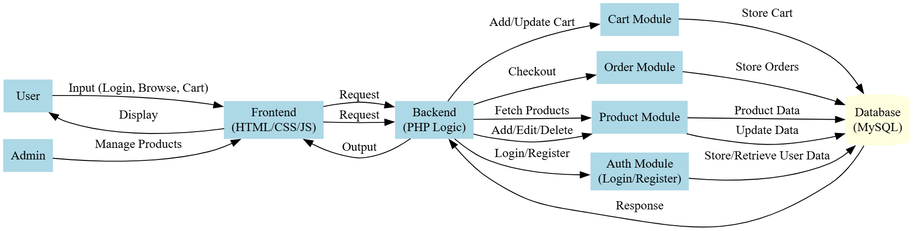
WORKFLOW

Slide 9
TECHNOLOGIES USED
7
FRONTEND:
HTML
CSS
JavaScript
BACKEND:
PHP
DATABASE:
MySQL
TOOLS:
XAMPP
VS Code
phpMyAdmin
HARDWARE/SOFTWARE REQUIREMENTS:
System with minimum 4GB RAM
Web browser (Chrome/Edge)
XAMPP Server installed

Slide 10
MODULE DESCRIPTION
8
🧑‍💻 Module 1: User Management
Handles user registration and login using secure authentication.
Stores user details such as name, email, and password in the database.
Maintains user sessions for secure navigation across pages.
Ensures only authorized users can access protected features.
🛍 Module 2: Product Management
Allows admin to add new products with image, price, and category.
Supports editing and deleting existing products.
Stores all product details in the database.
Displays products dynamically to users on the shop page.
Ensures efficient product organization and management.

Slide 11
MODULE DESCRIPTION
8
🛒 Module 3: Cart Management
Enables users to add products to the cart.
Supports updating quantity (increase/decrease) and removing items.
Stores cart data in the database for persistence.
Maintains cart even after page refresh or logout.
Calculates total price dynamically based on selected items.
📦 Module 4: Order Management
Handles checkout and payment process.
Stores order details including total amount and status.
Saves individual product details using order items.
Clears cart after successful order placement.
Allows users to view order history anytime.

Slide 12
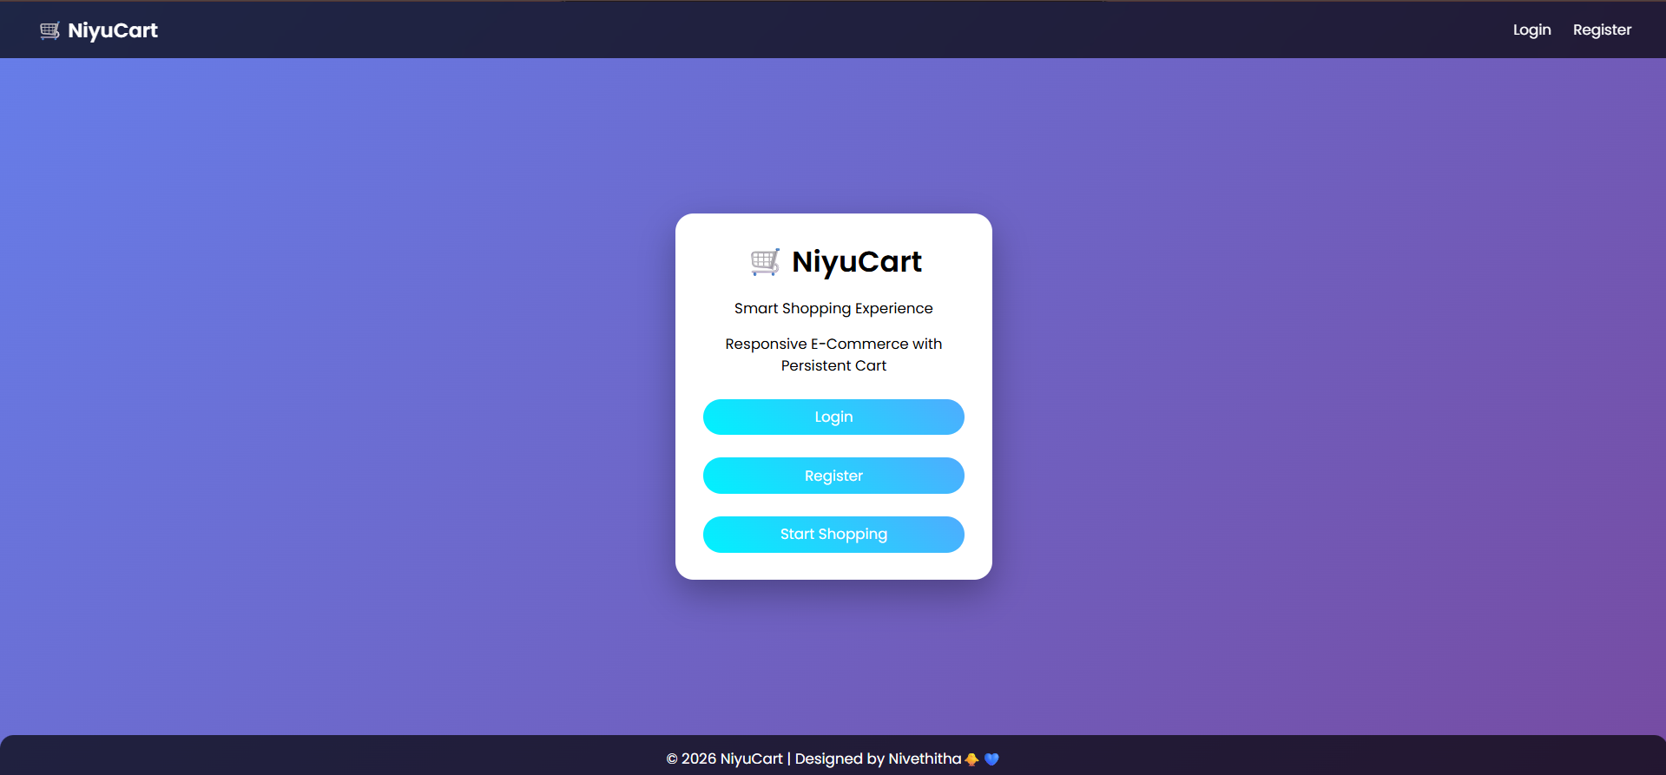
IMPLEMENTATION SCREENSHOTS
8
The home page provides a visually appealing landing interface with options to login, register, and start shopping.
It introduces the platform with a modern UI and guides users to access the system easily.

Slide 13
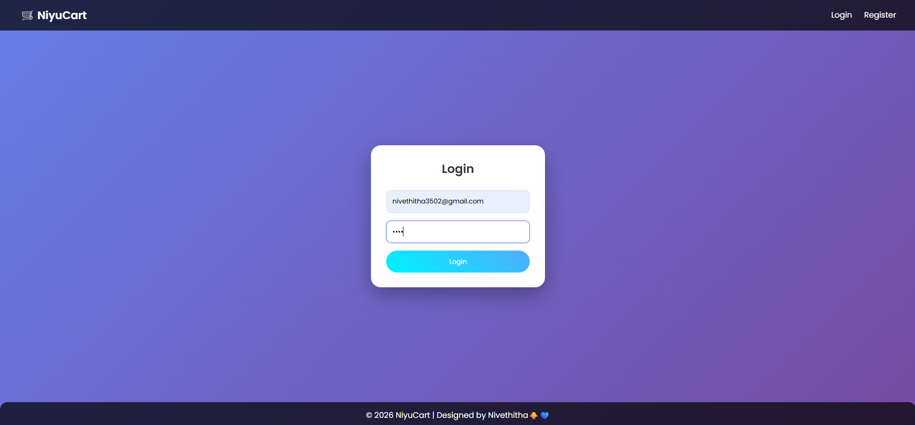
IMPLEMENTATION SCREENSHOTS
8(A)
The login page allows users to securely access their account using email and password authentication.
It ensures only registered users can proceed to shop and manage their cart.

Slide 14
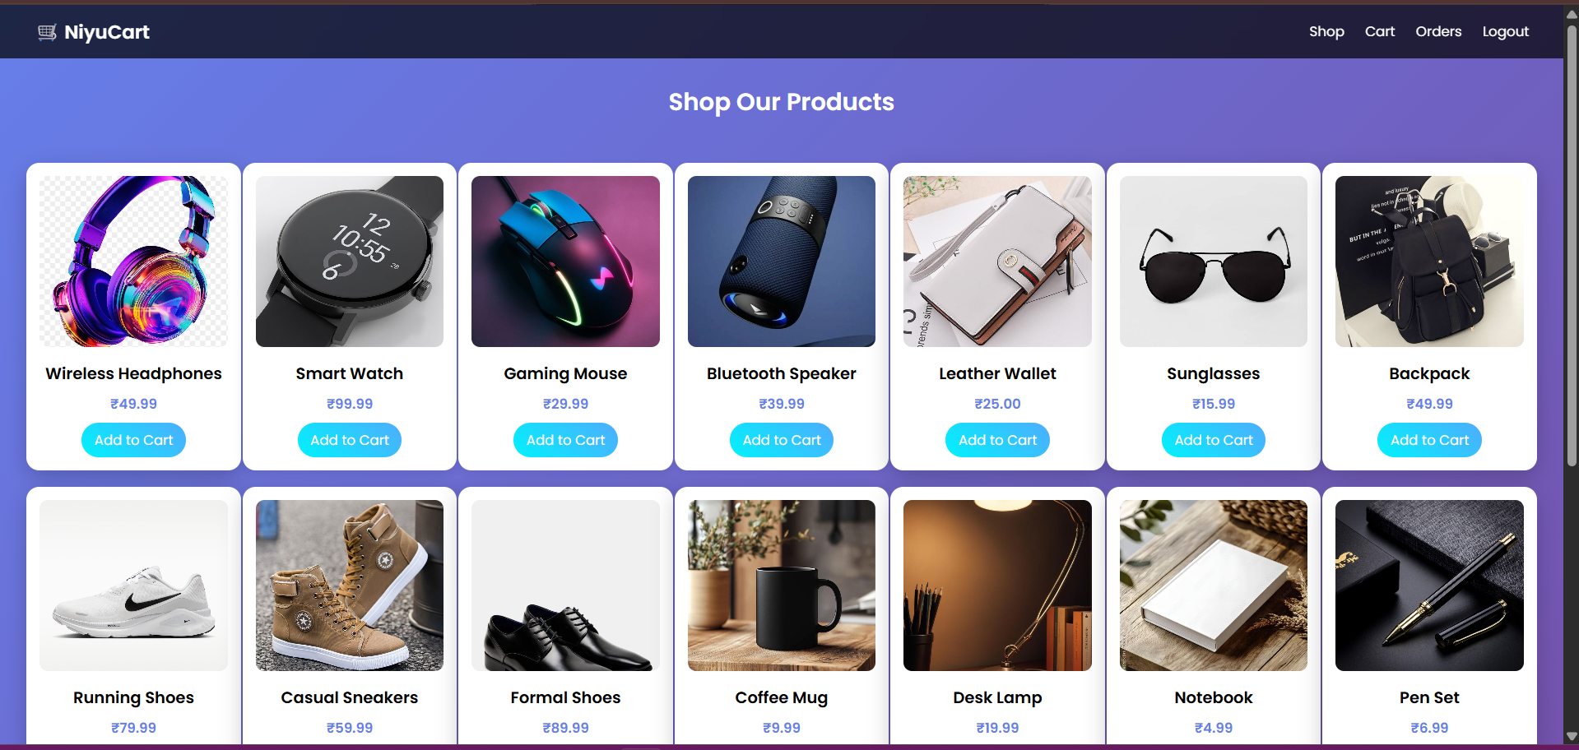
IMPLEMENTATION SCREENSHOTS
8(B)
Displays a list of available products dynamically with images, price, and “Add to Cart” option.
Users can browse products and add them to their cart, which is stored persistently in the database.

Slide 15
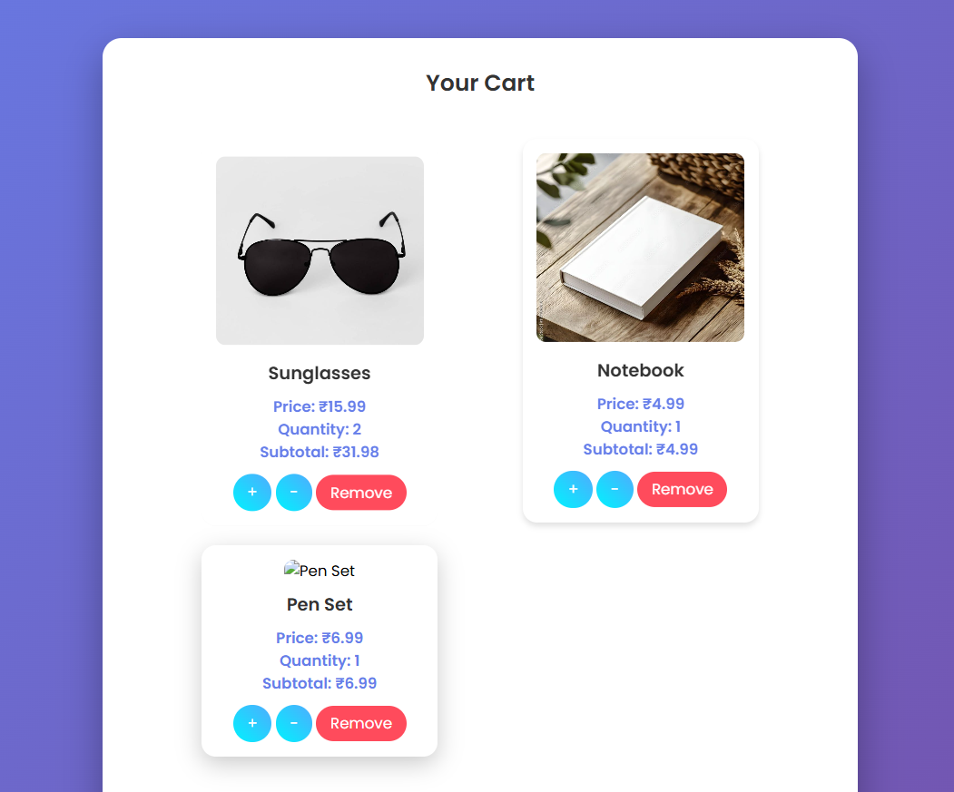
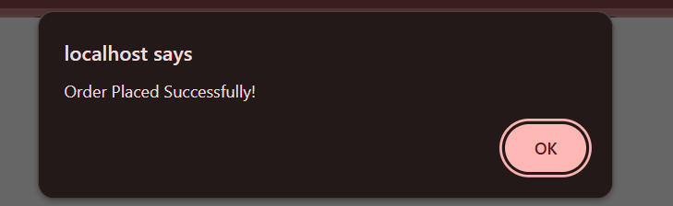
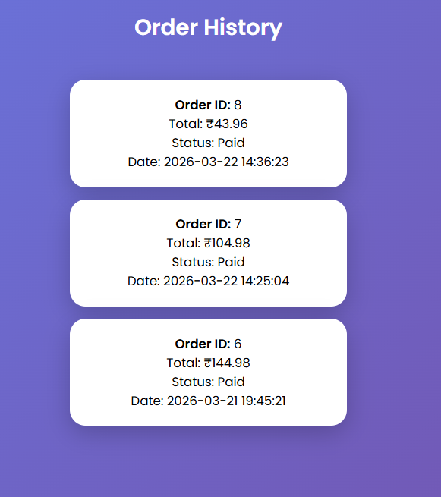
IMPLEMENTATION SCREENSHOTS
8(C)
Confirms successful order placement after completing the payment process.
Ensures that order details are stored and the cart is cleared for future purchases.

Slide 16
ADVANTAGES & LIMITATIONS
9
ADVANTAGES
Provides persistent cart storage using database (no data loss).
User-friendly and responsive interface for better experience.
Supports real-time cart updates (add/remove/quantity).
Efficient product and order management system.
Enables users to track order history easily.
LIMITATIONS
Payment system is simulated (no real payment gateway integration).
Limited scalability for large-scale commercial deployment.
Basic security features (can be enhanced with encryption & validation).
No advanced features like product recommendations or reviews.
Requires continuous internet connection to function.

Slide 17
Thank you

